Slide 1


Network & System Administration
Virtualization and Cloud Computing

Slide 2
Week | 7th Week
Day
Duration | 4hrs
Agenda
TIME | TOPIC & ACTIVITY | CPMPLETED-
30 Mins | Virtualization and Cloud Computing | Yes/No
60 Mins | Virtual machine management (e.g., VMware, Hyper-V) | Yes/No
15 Mins | Break | Yes/No
45 Mins | Cloud computing concepts and services (e.g., Infrastructure as a Service, Platform as a Service) | Yes/No
30 Mins | Q&A Session on lesson learnt | Yes/No
15 Mins | Break | Yes/No
60 Mins | Deployment and management of virtualized environments Cloud Security | Yes/No
15 Mins | Group Discussion | Yes/No

Slide 3
Learning Objectives
7.0 Virtualization and Cloud Computing:
7.1 Virtual machine management (e.g., VMware, Hyper-V)
7.2 Cloud computing concepts and services (e.g., Infrastructure as a Service, Platform as a Service)
7.3 Deployment and management of virtualized environments
7.4 Cloud Security

Slide 4
7.0 Virtualization and Cloud Computing

Slide 5
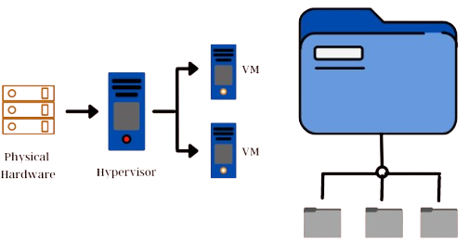
What is Virtualization?
Establishing a virtual, compared to an actual, version of something, such as an operating system, server, storage device, or network resources, is known as virtualization.
It builds a virtual system by using software or programs that simulate hardware functions. IT companies can run several operating systems, multiple virtual systems, and many applications on a single server because to this strategy. Increased efficiency and economies of scale .

Slide 6
What is cloud computing?
The term "cloud computing" describes the pay-per-use, on-demand supply of computer services via the internet, including applications, computing resources, storage, databases, networking resources, etc. The current demand for cloud computing services is growing, and this is also driving up the need for cloud computing expertise. It offers three primary service model types: Infrastructure as a Service (IaaS), Platform as a Service (PaaS), and Software as a Service (SaaS). Since more and more businesses, both small and large, are utilizing cloud services, they choose between several cloud types such as public, private, hybrid, and community clouds based on their needs.

Slide 7
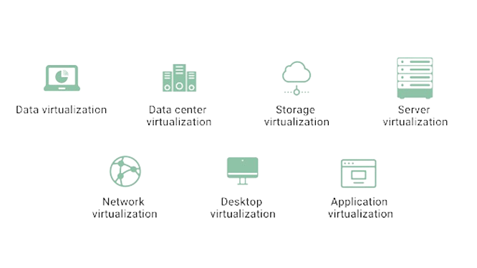
Types of Virtualization

Slide 8
The Benefits of Virtualization
1. Minimizes downtime and facilitates disaster recovery.
3. Allows better testing
A virtual machine can be moved to a different location quickly, especially in an emergency.
2. Increases productivity and efficiency
Fewer servers mean effective management of hardware and IT infrastructure. Managers can avoid the tedious task of applying updates to each server and leverage their accessibility of the virtual environment on the server to integrate changes across all the VMs.
A virtual environment offers a haven for developers to test their applications without disturbing the rest of the operations. They can duplicate a virtual system and run all the necessary tests.
4. Reduces carbon footprint
The higher the number of physical hardware devices, the higher the power consumption. By reducing the number of servers, IT companies can drastically reduce emissions and do their bit to save the environment.

Slide 9
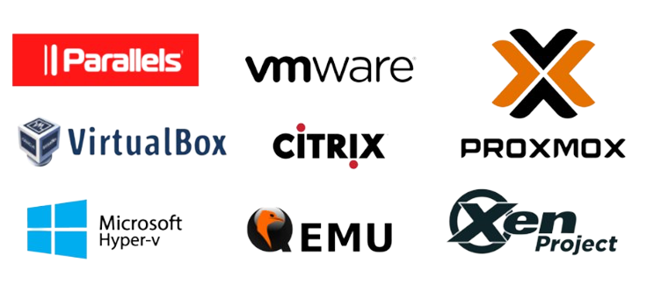
Virtualization Software's

Slide 10
7.1 Virtual machine management

Slide 11
Introduction to Virtual machine management
virtualization management links between virtual environments and the physical hardware behind them to improve data analysis, expedite processes, and make resource administration easier. Although every virtualization management system is different, the majority have an easy-to-use interface, speed up creating virtual machines (VMs), keep an eye on virtual environments, assign resources, provide reports, and automatically enforce policies. Users can install the management system that best suits their needs using certain systems, such as enterprise resource planning (ERP), which even integrate across hardware and software companies.

Slide 12
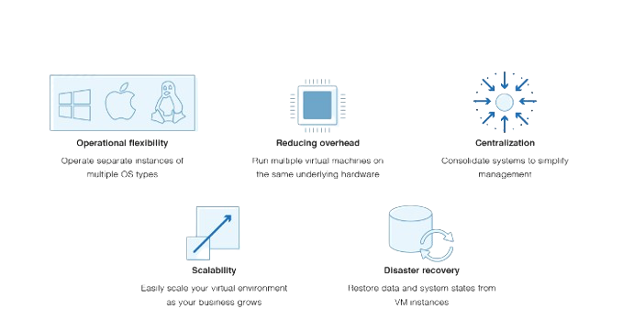
Benefits of VM

Slide 13
Introduction to VMware Overview
The definition of virtual machine (VM) is simple. Virtual machines' primary function is to run several operating systems concurrently on a single piece of hardware. Operating two different operating systems, such as Windows and Linux, would require two separate physical units if virtualization wasn't used.
Introduction to Hypervisor
A virtual machine's core is a software program known as a hypervisor. In the cloud, a hypervisor serves to isolate a single virtual machine. A hypervisor is much more than just a partition for your virtual machines. Apart from creating an unbreakable virtual barrier between several operating systems, your hypervisor will also replicate the physical elements of a conventional operating system. Your hypervisor will provide virtualized representations of physical resources like as CPU, memory, I/O, and others.

Slide 14
Lab on VMware
Download link for VM workstation (https://www.vmware.com/products/workstation-player/workstation-player-evaluation.html.html)
Lab demo on VM Installation.

Slide 15
Lab on Hyper-V
Right-click on the Windows button and select “Apps and features.”
Then, on the right, under settings, select “Programs and features.”
Choose “Turn Windows features on and off.”
Check the Hyper-V checkbox, click “OK,” and follow the prompts to install it.
follow these steps to create a new virtual machine with a guest operating system.
Open Hyper-V Manager. Click the “Start” button.
Start creating your virtual machine. From the “Action” pane, click “New” then “Virtual machine.” From “New virtual machine wizard,” click “Next.”
Pick the appropriate VM settings. At this stage, you’ll need to follow the virtual machine wizard to finish setting things up.
Verify your choices. After choosing your settings, you will need to verify that you’ve set everything up correctly on the summary page. When you’ve checked your settings, click “Finish.”
Start your virtual machine.

Slide 16
7.3 Cloud computing concepts and services

Slide 17
Introduction to Cloud Computing
Cloud computing refers to the practice of storing and accessing data and applications on remote servers hosted over the internet, as opposed to local servers or the computer's hard drive. Cloud computing, often known as Internet-based computing, is a technique in which the user receives a resource as a service via the Internet. Files, photos, documents, and other storable documents can all be considered types of data that are stored.
Some of the operations that can be carried out with cloud computing include the following.
Data recovery, backup, and storage
On-demand software delivery
creation of fresh services and applications
Audio and video streaming

Slide 18
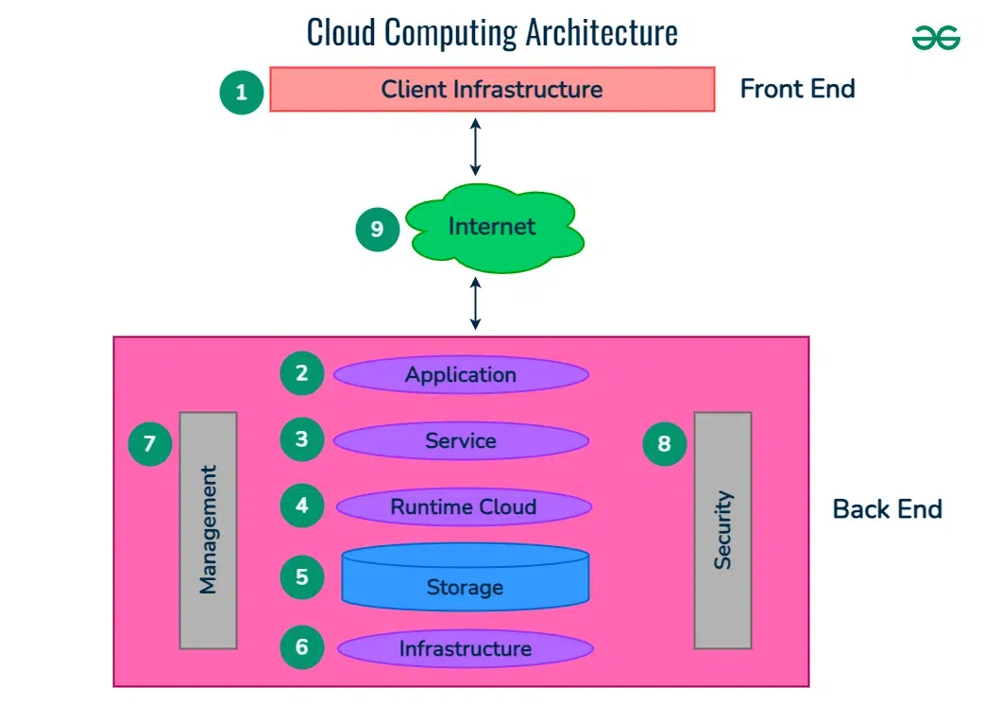
Architecture Of Cloud Computing
Architecture Of Cloud Computing
Cloud computing architecture refers to the components and sub-components required for cloud computing. These components typically refer to:
Front end ( Fat client, Thin client)
Back-end platforms ( Servers, Storage )
Cloud-based delivery and a network ( Internet, Intranet, Intercloud )

Slide 19
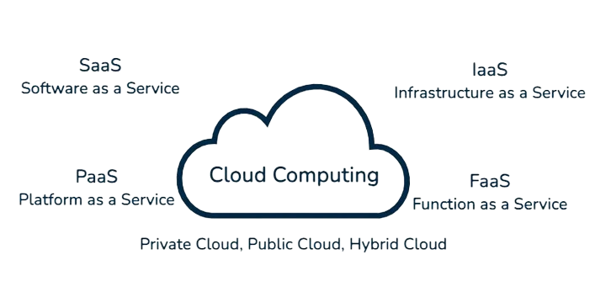
Types of Cloud Computing Services

Slide 20
Infrastructure as a Service ( IaaS )
A type of cloud computing known as Infrastructure as a Service (IaaS) uses the internet to deliver virtualized computer resources. Along with Platform as a Service (PaaS) and Software as a Service (SaaS), Infrastructure as a Service (IaaS) is one of the three primary types of cloud computing services.
Key Features of IaaS:
Virtual computers: Infrastructure as a Service (IaaS) provides virtual computers for rent that may be utilised much like real machines.
Storage: Offers virtual hard drives and other scalable storage options.
Networking: Contains IP addresses, load balancers, and virtual networks, among other networking features.
Data Centres: The service provider is responsible for maintaining the servers and storage devices contained within the physical infrastructure.
Scalability: Depending on demand, resources can be scaled up or down.

Slide 21
Platform as a Service ( PaaS )
A cloud computing architecture known as Platform as a Service (PaaS) gives customers access to a platform that lets them create, execute, and manage applications without having to worry about the supporting infrastructure. PaaS provides a thorough platform with all the components developers require to create and launch apps, including:
Operating System: The application-running operating system that runs behind the surface.
Middleware is software that links several services and apps to enable data management and communication.
Runtime Environment: The environment and parts required to run programmes, such as libraries and programming languages.
Database management refers to the services and tools used to handle databases, including the storing, retrieving, and modifying of data.

Slide 22
Platform as a Service ( PaaS )
Key Features of PaaS:
Important PaaS Development and Deployment Features: offers a ready-made platform for the rapid development, testing, and deployment of apps.
Scalability: The ability to adjust resources automatically to meet demand.
Integration: Provides middleware, database, and other application integration.
Management: Makes hardware and software infrastructure management less complicated.
Economical: reduces the requirement for an initial infrastructure investment with a pay-as-you-go model.

Slide 23
SaaS (software as a service)
Software as a Service (SaaS) is a type of software distribution where clients can access applications via the internet, hosted by a third-party provider. The main features of SaaS are as follows:
Cloud-Based Delivery: Software as a Service (SaaS) programmes are made available to consumers via the internet, enabling them to access them from any internet-connected device.
Subscription-Based: Users of the software normally pay a regular subscription fee, which can be deducted from their paycheck on a monthly or yearly basis.
Updating and Maintenance: To lessen the load on the user, the SaaS provider handles all software maintenance, including security patches, updates, and technical assistance.
Scalability: Without requiring any modifications to the current infrastructure, SaaS solutions can be readily scaled to meet the needs of an expanding user base or an increase in data consumption.

Slide 24
Function as a Service (FaaS)
A cloud computing service architecture called Function as a Service (FaaS) enables developers to run code in response to events without having to worry about maintaining the underlying infrastructure. This approach is a subset of serverless computing, in which the provisioning, scaling, and management of servers is automatically taken care of by the cloud provider.
Key features of FaaS include:
Event-Driven Execution: Certain events, such HTTP requests, database modifications, or communications from other services, cause functions to be executed. Applications can now be responsive and efficient as a result.
Automatic Scaling: In response to demand, the cloud provider automatically adjusts the number of function instances. This indicates that functions don't need human assistance to handle different loads.

Slide 25
Function as a Service (FaaS)
No Server Management: The underlying infrastructure, including server upkeep, updates, and scalability, is not a concern for developers. The cloud provider takes care of everything, freeing developers to concentrate just on developing code.
Billing based on Usage: With FaaS, you only pay for the time that your functions actually execute. As a result, expenses are directly related to utilisation, which could result in financial savings over more conventional always-on server configurations.

Slide 26
Q&Q Session on Lesson learned

Slide 27
Q&Q Session
Q1: What is a hypervisor, and what role does it play in virtualization?
A1: A hypervisor, also known as a virtual machine monitor (VMM), is software that creates and manages virtual machines (VMs) by allocating resources such as CPU, memory, and storage from the host physical machine to each VM. It enables multiple operating systems to run concurrently on a single physical machine by abstracting the underlying hardware.
Q2: What are the main differences between Type 1 and Type 2 hypervisors?
A2:
Type 1 Hypervisors (Bare-metal): These hypervisors run directly on the host's hardware to manage guest operating systems. Examples include VMware ESXi and Microsoft Hyper-V. They are typically more efficient and provide better performance and security.
Type 2 Hypervisors (Hosted): These hypervisors run on a conventional operating system just like other computer programs. Examples include VMware Workstation and Oracle VM VirtualBox. They are easier to set up and use but generally offer lower performance compared to Type 1 hypervisors.

Slide 28
Q&Q Session
Q3: What is Infrastructure as a Service (IaaS), and what are some common use cases?
A4: IaaS provides virtualized computing resources over the internet, including servers, storage, and networking. Common use cases include:
Development and Testing: Quick provisioning of development environments.
Website Hosting: Scalable hosting solutions for websites and web applications.
Storage, Backup, and Recovery: Reliable and scalable storage solutions.

Slide 29
7.3 Deployment and management of virtualized environments

Slide 30
Virtualization Deployment Models
There are two methods being used to implement virtualization. Multiple server applications were deployed on a single physical machine through the early use of virtualization. For example, three virtual servers hosted on the same physical server can run three different types of servers: Citrix, Web, and Oracle database. Applications that were unable to utilize the servers' increased RAM availability also required this kind of server virtualization, necessitating the hosting of several application instances, one for each virtual server.

Slide 31
Using virtualization as a substitute for conventional server-based computing systems is a relatively recent trend. Users connect to virtual desktops using the remote desktop protocol (RDP) or an analogous method, launch their client programs, and access virtual desktops—rather than servers—on the virtual hosts in these virtual desktop infrastructures (VDI). Each user in this scenario has a virtual desktop that they can utilize to execute their apps. The operation of a virtual desktop infrastructure is shown in Figure 1. Simple brokering approaches are typically employed to facilitate end-user connectivity to virtual machines. Here, end users are given the connection broker's corporate network web address. Following authentication, the connection broker gives the user access to a list of available resources to the end user. The end-user establishes a connection directly to the virtual machine using RDP.

Slide 32
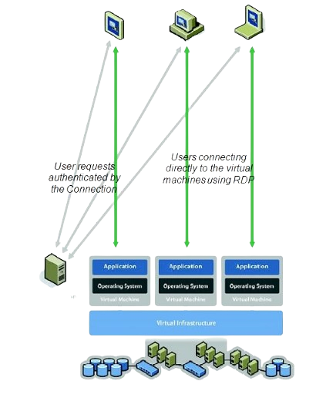

Slide 33
7.4 Cloud Security

Slide 34
Example: Process of Incident Response
Form a special incident response team.
Determine the essential resources and elements.
Make the plan for responding to incidents.
All staff members should receive training.
Determine which factor led to the occurrence.
Limit, intensify, or eliminate.
Assess the damage.
Communicate to each other.
Recover and monitor.

Slide 35
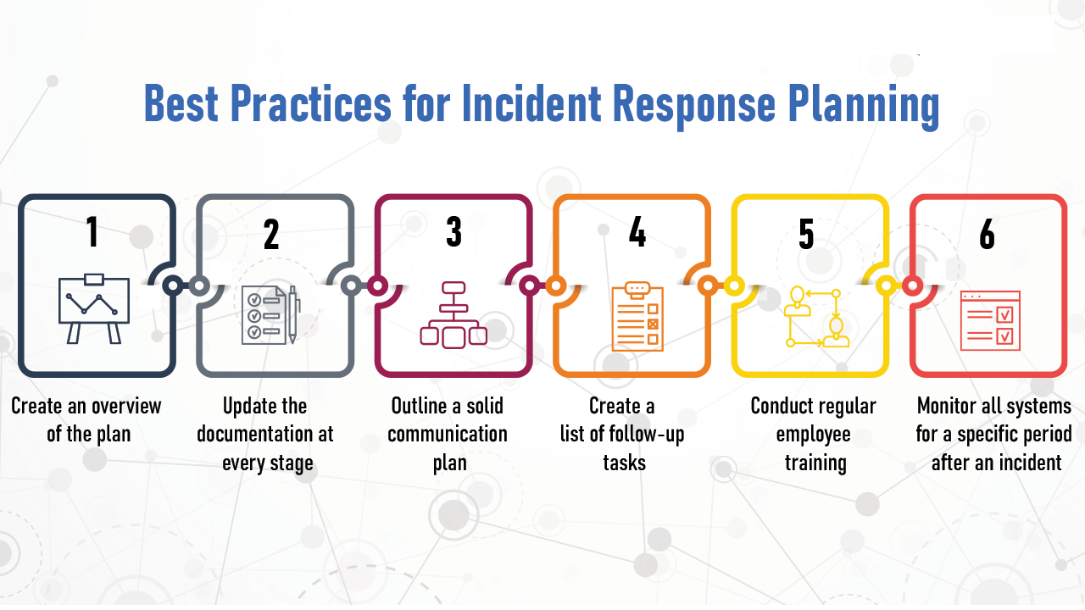
Example: Best Practices for Incident Response Planning

Slide 36
Group Discussion
Virtualization and Cloud Computing:
Virtual machine management (e.g., VMware, Hyper-V)
Cloud computing concepts and services (e.g., Infrastructure as a Service, Platform as a Service)
Deployment and management of virtualized environments

